Slide 1

A Comprehensive Analysis of Blockchain-Based Voting Systems: Enhancing Transparency and Security
Md. Atik Ullah Khan, Sumaiya Sultana Tarin,
Mushfequr Rahman, Ahsanul Azmain,
Md. Faruk Abdullah Al Sohan
American International University-Bangladesh

Slide 2

Outlines
Introduction
Research Gaps
Research Objectives
Proposed Model
Working Principle of the Model
Outcomes & Challenges
Conclusion

Slide 3
Introduction
Traditional voting methods face issues with transparency, security, and reliability.
Blockchain can address these issues by recording each vote as an unchangeable transaction that all participants can verify.
Blockchain ensures that votes are accurately counted and cannot be tampered with, reducing the risk of fraud or manipulation.
Blockchain enables remote voting, making it easier for eligible voters to participate.
Implementing blockchain in voting systems has the potential to revolutionize the way elections are conducted and restore trust in the democratic process.

Slide 4
Research Gaps
Scalability
Traditional voting processes struggle to efficiently handle large-scale elections, especially in terms of speed and resource management
Privacy
Traditional systems may expose voter identities or lack adequate measures to guarantee voter anonymity
Transparency
Traditional voting systems often lack real-time, verifiable transparency, leading to distrust in the voting process
Voting fraud
Traditional systems are vulnerable to voter fraud, such as impersonation, ballot stuffing, and vote manipulation

Slide 5
Research Objectives
Voting transparency
To increase voting transparency by providing an immutable ledger
Security
To enhance voting security with encryption and decentralized protection against cyber threats
Voter privacy
To preserve voter privacy using cryptographic techniques while maintaining vote integrity
Fraud resistance
To prevent fraud by securing votes against tampering, duplication, or alteration
Scalability
To scale for large elections without compromising speed or security

Slide 6
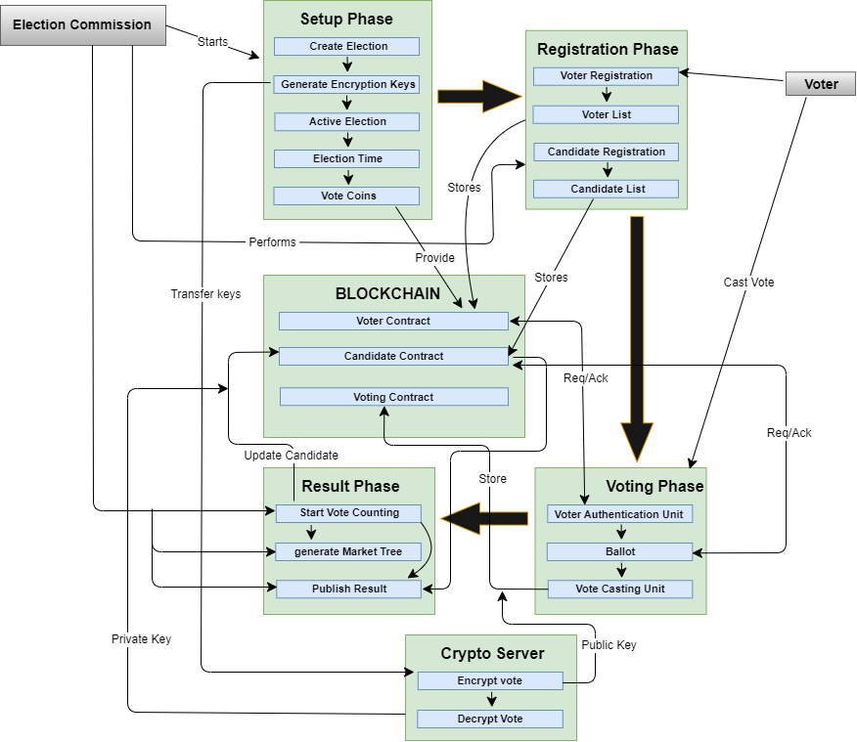
Proposed Model
Blockchain-Based Voting System

Slide 7
Working Principle of the Model
Setup Phase: Election creation and activation. Generation of encryption keys and vote coins.
Registration Phase: Voter and candidate registration, verified and stored on the blockchain.
Voting Phase: Voter authentication, vote casting, and storage on the blockchain.
Result Phase: Decryption and counting of votes, publishing immutable results.

Slide 8
Outcomes & Challenges
Increase Privacy: Cryptographic methods (zero-knowledge proofs, homomorphic encryption) ensure voter anonymity.
Transparency: Immutable blockchain ledger allows public verification of results.
Challenges: Technical complexity, voter education, public trust, and compliance with varying regulatory standards.

Slide 9
Conclusion & Future Work
Blockchain has the potential to revolutionize voting systems by enhancing security and transparency.
Cryptographic techniques ensure voter privacy and protect against fraud.
Future Works: Integrating biometric technologies, standardization, and legal frameworks for wider acceptance.

Slide 10


